Slide 1
Analyzing and Using Deep Learning Approach in Sports Domain
Module - Data Mining & Machine Learning 2
BY:- MAITREYA LAVALEKAR (x23209976)

Slide 2

NOTE:
To change images on this slide, select a picture and delete it. Then click the Insert Picture icon
in the placeholder to insert your own image.
AGENDA
Introduction.
Motivation & Data Source.
Selection of Technique.
Exploratory Data Analysis.
Implementation of Technique.
Evaluation and Result.
Conclusion and Future Work.

Slide 3
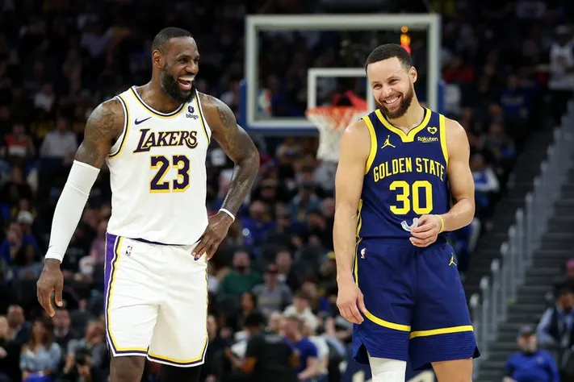
Introduction
Importance of Data Analytics in Sports
Importance of Choosing Analytics in NBA Accurate player evaluations and performance predictions are crucial for success in the league
Objective Use deep learning techniques to predict whether an NBA player will be selected as an All-Star based on their performance metrics.
Methodology - KDD Convolutional Neural Network (CNN). Captures most of the trends for accurate predictions.

Slide 4
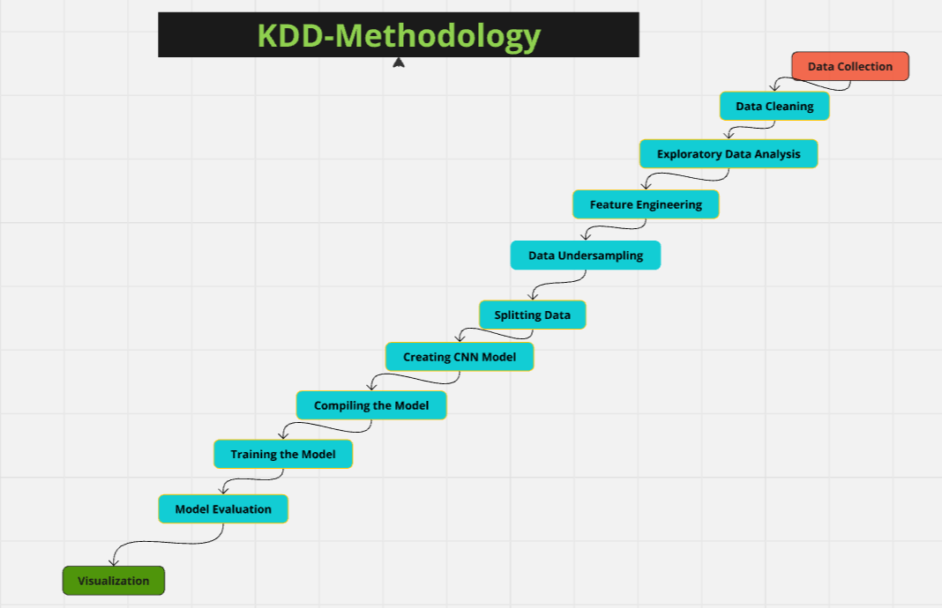
Implementation of Technique
Data Collection: Data was collected from Kaggle.
Data Cleaning: Remove missing values, duplicates, correct inaccuracies, convert data types.
Exploratory Data Analysis: Identify patterns, visualize player position, and various aspects of players.
Feature Engineering: Creating new features.
Data Sampling: Under-sampling was performed.
Splitting Data: 70% training, 30% testing.
Model Architecture: CNN layers with dropout, dense output layer.
Model Compilation: Using Adam optimizer.
Model Training: 20 epochs, batch size 64, early stopping.
Model Evaluation: Accuracy, F-1 score, Recall, Precision.
Visualization: Graphs: Actual vs. predicted players

Slide 5
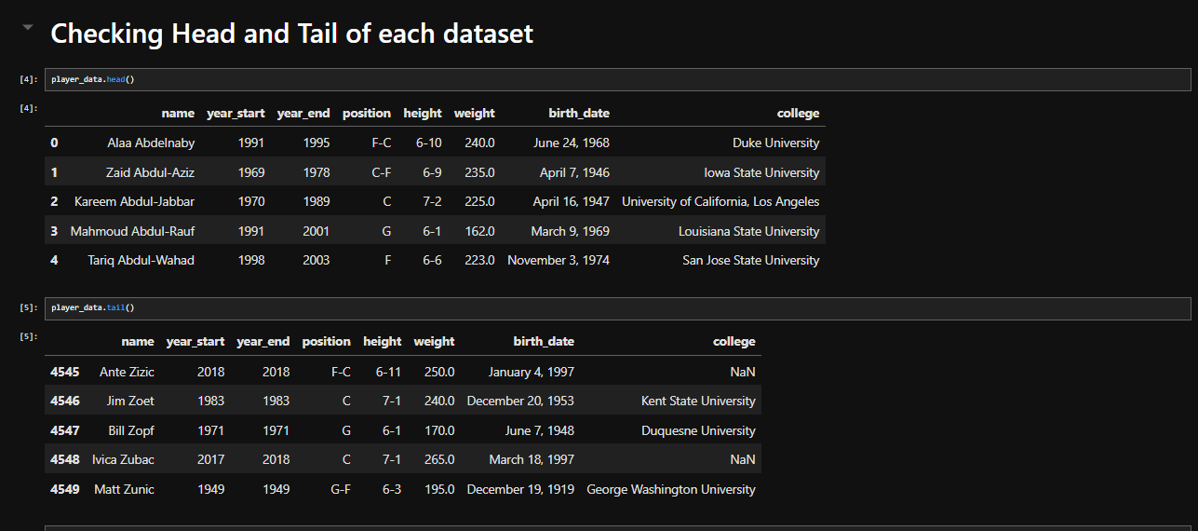
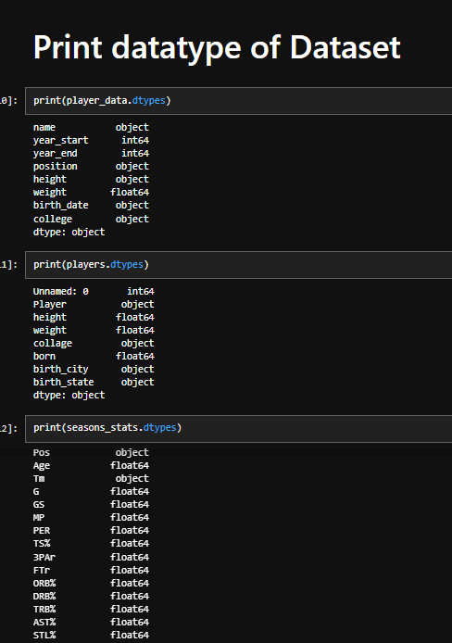
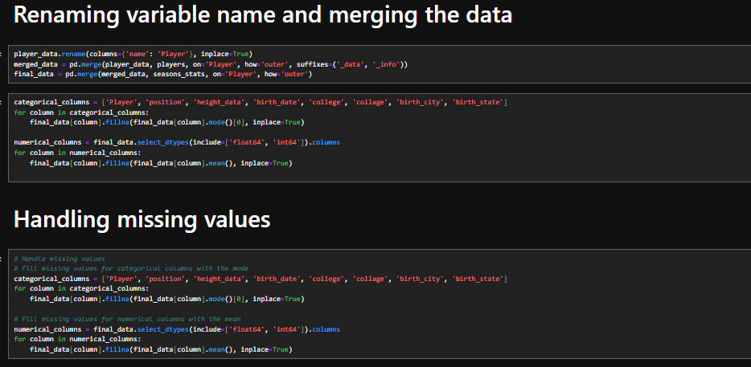
Data Collection and Data Preprocessing
Data collection – Kaggle website
Dataset features– Player names, weight, height, various stats, duration of career and many more…
Data Preprocessing – Data Cleaning, Renaming variable, Handling Missing Values, Conversion into numeric data,

Slide 6
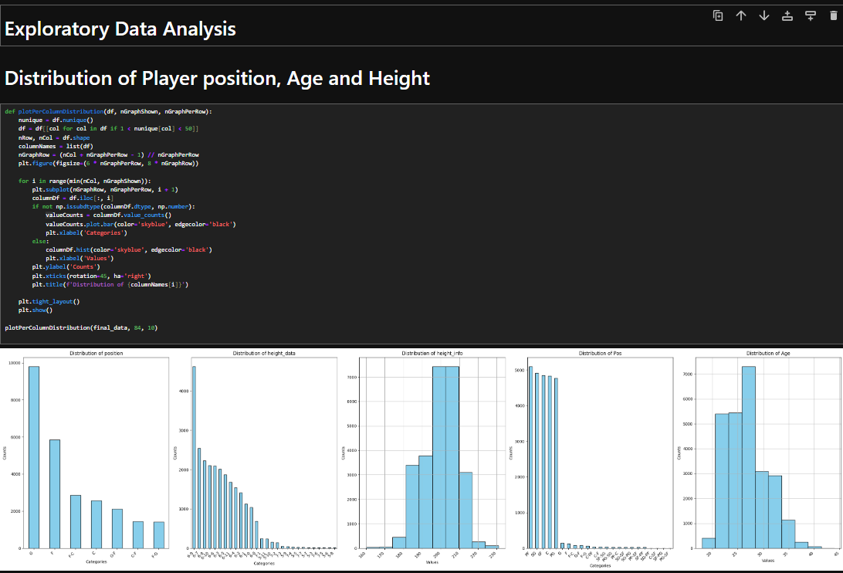
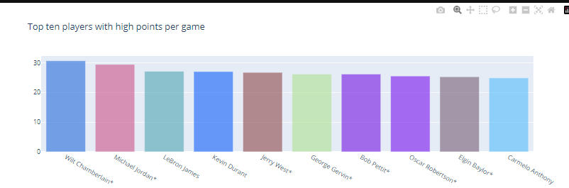
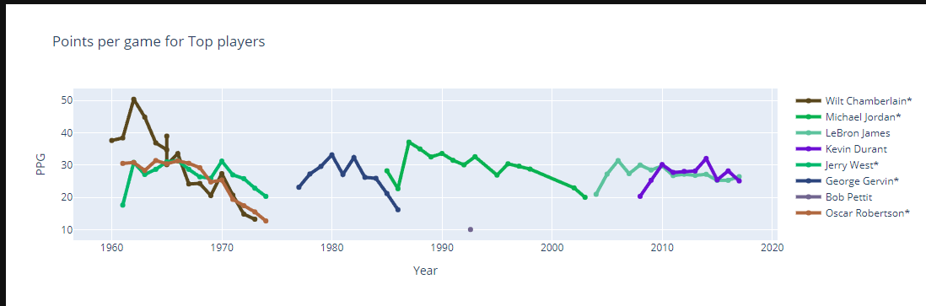
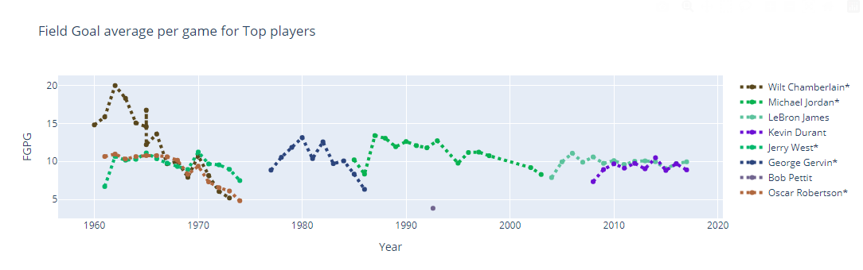
Exploratory Data Analysis
EDA is mostly used to gain insights from the features. It also helps for better understanding of data.

Slide 7
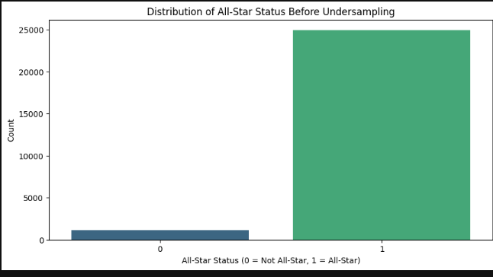
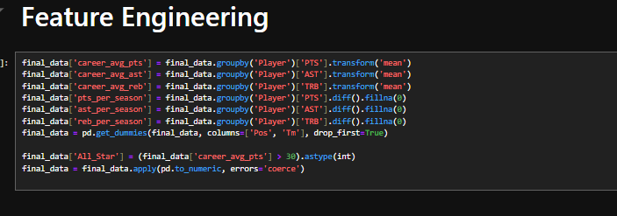
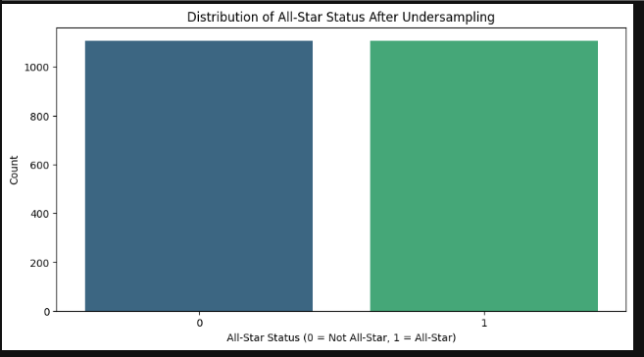
Feature Engineering and Under-sampling
Feature Engineering helps to create new features or extract new features important for analysis.
Under-sampling is a method of handling imbalance data by creating equal sample for both the values.

Slide 8
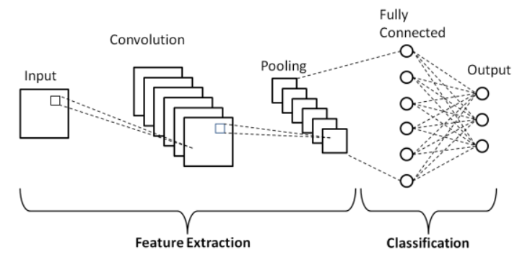
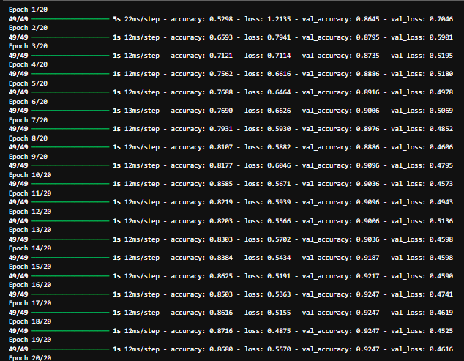
Data Splitting and Model Building
Splitting data in 70/30 ratio
Convolutional Neural Network
Logs of Model

Slide 9
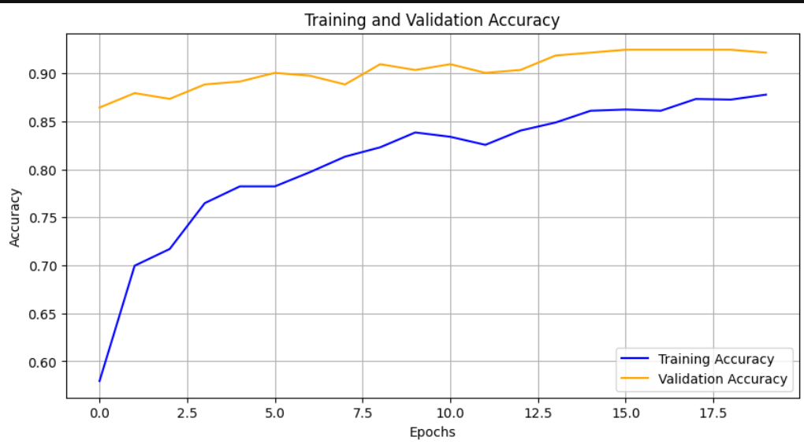
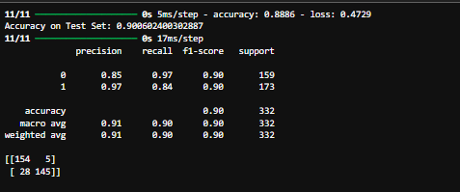
Result and Analysis
Accuracy for training : 0.8886 Loss : 0.4729 This explains ~88% accuracy on training data
Training and Validation Loss: The training loss consistently decreases over epochs, while the validation loss decreases and stabilizes, indicating good learning with no significant overfitting.
Accuracy for testing : 0.9006 This explains ~90% accuracy on training data

Slide 10
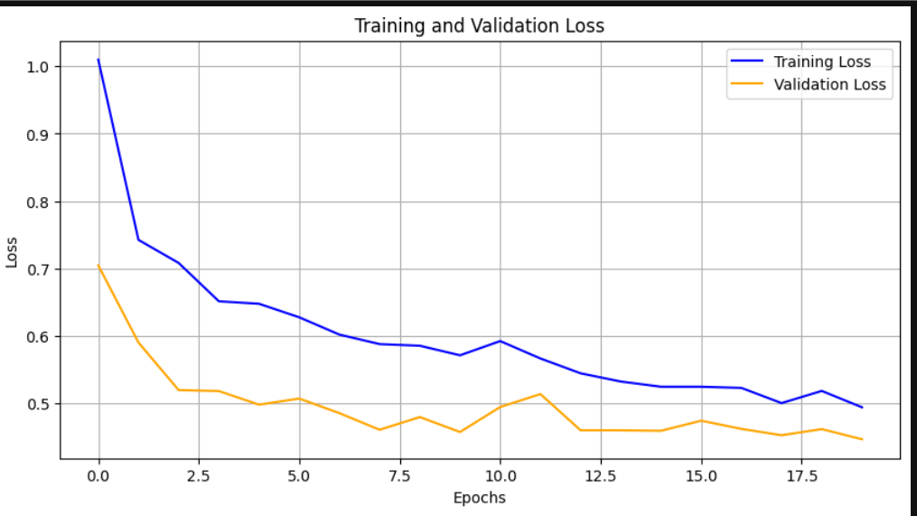
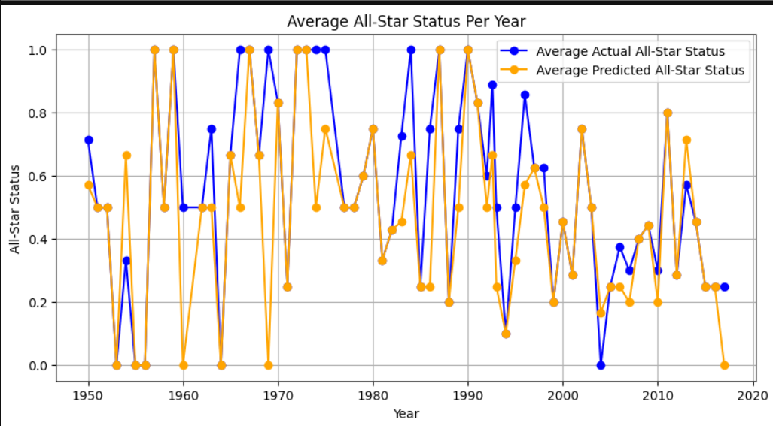
Training and Validation Accuracy: The training accuracy improves steadily, while the validation accuracy remains high and stable, demonstrating that the model generalizes well to unseen data.
Average All-Star Status Per Year: The average predicted All-Star status closely follows the trend of the average actual All-Star status over the years, showcasing the model's predictive capability.

Slide 11
THANK YOU.

